Slide 1
Weekly Update #2
Team Name: EM Drop the Microelectronics
Project Manager: Barak Barclay
Logistics & Finance Manager: Alicia Lawrence
Design Manager: Brian Griffen
Test Manager: Chris Sherwood
Sponsor: EM Microelectronic
Faculty Sponsor: Dr. Byeong Lee
22 March 2019

Slide 2
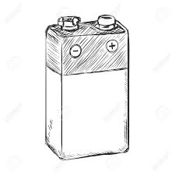
Problem: 9V Battery Low Voltage Detection
Some products need to have their batteries replaced before the battery dies completely
Our team must design a board that checks that voltage and broadcasts once the voltage is critical
Broadcasts only when low
Sends BT packet

Slide 3

Bluetooth Specifications
Bluetooth Version 5.0
EM9304
Bluetooth Packet Type
Non-connectable vs. Connectable
Power Consumption vs. Need for Pairing
EM9304
Certified w/ FCC for wireless transmission
Supports 1.5V & 3V batteries
Low-power switching regulator

Slide 4
Battery Specifications
Battery Current Consumption
Reduction of less than 20%
Battery Alternatives
Alkaline vs. Lithium Ion
Cost vs. Capacity
Total part cost <$5 at 10,000 units
Temperature Range?
Size
Inner vs. Outer Module
Battery Dimensions
Max: 48.5mm x 26.5mm x 17.5mm
Standard: 48mm x 25mm x 15mm

Slide 5

System Block Diagram
Battery powers entire system
Need voltage stepped down for EM9304 which operates at 1.5 or 3.0 V
Some type of circuitry detects voltage or current from sense line to EM9304

Slide 6
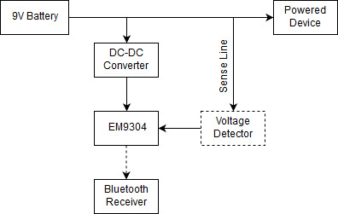
System Block Diagram

Slide 7
Resistive Load
To properly characterize battery we need an idea of load
Loads vary between photoelectric, ionization, and combination detectors
Manufacturer | Model | Product | Type of value | Average Current [uA] | Load Resistance [kOhms]
ANSI | - | Battery | Spec | 209.3 | 43
Ultra Life | U9VL-X | Battery | Calculated | 13.7 | 657
First Alert | SA303 | Smoke Alarm | Measured | 7.3 | 1,233

Slide 8
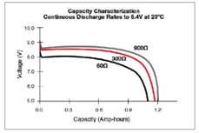
Battery Characterization Tests
Use current source instrument to develop battery IV curves
With IV curve data we can find ideal voltage to start advertising
Need a reliable method to drain battery to certain percentages for tests

Slide 9

Plans for Next Week
Test various batteries for IV curves
Decide on a battery
Decide on a percentage for the BLE advertisements to start
Study battery tests, profiles, and models that have already been published

Slide 10
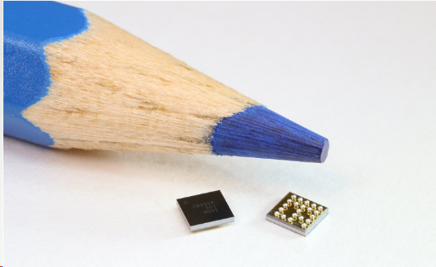
Thank You for Listening
Any Questions?

